Slide 1

Name : GIRIDHARAN M
Reg No: 24102047
Expense Manager Using Python
CSV & File Handling Based Application

Slide 2





Abstract: Streamlining Financial Tracking
This project introduces an intuitive Expense Manager application developed using Python, designed to simplify personal and small- scale financial tracking. Leveraging CSV files for primary data storage and text files for robust backups, the system ensures data integrity and easy accessibility.
Python Powered
Core logic and functionality built with Python for efficient processing.
CSV & File Handling
Data persists through CSV files with additional text file backups.
Key Functionalities
Add, view, and summarize expenses with ease.

Slide 3

Introduction: The Importance of Expense Tracking
An Expense Manager is a digital tool designed to help individuals and small businesses monitor and categorize their spending. In an increasingly complex financial landscape, understanding where money goes is crucial for effective budgeting and financial health.
What is an Expense Manager?
A software application that records, organizes, and analyzes financial transactions, offering insights into spending habits.
Why Track Expenses?
Essential for budgeting, identifying unnecessary expenditures, achieving financial goals, and maintaining fiscal discipline.
Motivation for this Project
Driven by the need for a simple, reliable, and user-friendly solution to overcome the limitations of manual expense tracking.

Slide 4

Problem Statement: The Challenges of Manual Tracking
Traditional methods of expense management often lead to inaccuracies, missed entries, and difficulty in analysis. Without a systematic approach, financial oversight becomes a daunting task.
Manual Tracking Difficulties
Prone to human error, time- consuming, and inconsistent, leading to an incomplete financial picture.
Lack of Data Backup
Physical records are susceptible to loss or damage, leaving no recoverable history of transactions.
Absence of Digital Simplicity
A clear need for an easy-to- use digital log that provides a quick overview and detailed reports.

Slide 5




Project Objectives: Building a Robust Solution
This Expense Manager aims to address the identified problems by providing a streamlined, secure, and insightful financial tracking tool.
Record Expenses Easily
Develop an intuitive interface for quick and efficient expense entry.
Store Data Securely
Implement reliable storage mechanisms using CSV files to ensure data persistence.
Maintain Backup Logs
Automate the creation of text file backups for disaster recovery and historical archiving.
Provide Total Calculations
Enable users to view cumulative spending and summaries over specified periods.

Slide 6

Understanding the Existing System: A Manual Burden
The current approach to managing expenses primarily relies on manual methods, which are inherently inefficient and prone to significant drawbacks.
Without automation, individuals often resort to:
Keeping physical receipts that can easily be lost or damaged.
Maintaining handwritten ledgers or basic spreadsheets that lack advanced functionality.
Performing calculations manually, increasing the risk of errors.
This system is not only time-consuming but also provides limited insights into spending patterns, making effective financial planning challenging.

Slide 7



The Proposed System: Automated & Efficient
Our Python-based Expense Manager offers a modern, automated solution to financial tracking, providing ease of use and reliability.
Automated Recording
Expenses are captured and categorized digitally, eliminating manual entry errors.
CSV Storage
Primary data stored in structured CSV files for easy integration and analysis.
TXT Backup Logs
Automatic plain text backups provide an additional layer of data safety.
Easy Retrieval & Totals
Quickly access past records and view comprehensive spending summaries.

Slide 8


Key Features of the Expense Manager
The system is designed with a comprehensive set of features to cater to essential expense management needs, ensuring a user- friendly experience.
1 2 3
Add Expense
Allows users to quickly input new expenditures with details like amount, date, and description.
View All Expenses
Provides a chronological list of all recorded transactions for easy review.
View Total Spending
Calculates and displays the sum of all expenses or expenses within specific criteria.
4
5
Backup File Creation
Generates a separate text file containing all expense data as a robust backup mechanism.
Category-Based Records
Optional feature to categorize expenses (e.g., food, transport) for detailed financial analysis.

Slide 9




System Architecture: Data Flow at a Glance
The architecture of the Expense Manager is designed for simplicity and reliability, ensuring a clear flow of information from user input to secure storage and backup.
User Input
Enter expense details via form or CLI.
Python Program
Process, validate, and format records.
CSV File Storage
Append structured records for reporting.
TXT Backup
Write plain-text backups for resilience.
This structured approach guarantees that all financial data is processed, stored, and protected effectively, providing both immediate access and long-term security.

Slide 10
Architecture Explained: Components & Interaction
Each component in the system architecture plays a vital role in the efficient operation and data integrity of the Expense Manager.
User Input
The interface where users interact with the system to enter expense details. This could be a command-line interface or a simple GUI.
Python Program
The core logic that processes user input, performs calculations, manages data, and interacts with the storage components.
CSV File Storage
The primary repository for all expense records. Data is stored in a structured, comma-separated values format, making it easy to read and manipulate.
TXT Backup
An essential safety net. A duplicate of the expense data is saved in a plain text file, providing a simple, human- readable recovery option.

Slide 11

Effortless Expense Tracking: A Simple Solution
Welcome to a presentation on a straightforward, user-friendly tool designed to simplify your financial management. This project aims to bring clarity and control to your daily spending, ensuring every penny is accounted for with minimal effort.

Slide 12

Understanding the Flow: How It Works
Start
Launch the application to begin.
Menu
Choose an action: Add, View, or Total.
File Operations
Perform read/write operations on records.
Display Output
Show reports and final results.
The system guides you through a clear, logical process. From starting the application to managing your expenses and viewing reports, each step is intuitive, ensuring a smooth experience from input to output.

Slide 13




Core Components: Modules at Work
Input Module
Captures all your expense details with precision.
CSV Writer Module
Organizes and stores your data efficiently in CSV format.
Backup Logger
Ensures data safety through automated backups.
Calculator Module
Performs quick and accurate expense calculations.
Display Module
Presents your financial data clearly and concisely.

Slide 14





Technology Under the Hood
Python
The robust and versatile programming language powering the application.
CSV Module
Facilitates seamless reading and writing of comma- separated values.
File Handling
Manages efficient storage and retrieval of expense records.
DateTime
Ensures accurate timestamping and organization of entries.

Slide 15





Key Advantages: Why This Tool?
User-Friendly
Intuitive design makes it easy for anyone to manage expenses.
Fast s Simple
Quick data entry and immediate results save you time.
Permanent Storage
Your financial history is securely stored for future reference
.
Backup for Safety
Automated backups protect your valuable financial data.

Slide 16



Who Benefits? Ideal Use Cases
Students
Perfect for tracking student budgets and managing daily expenses.
Daily Budgeting
Helps individuals maintain control over their everyday spending.
Simple Finance Tracking
A straightforward solution for basic personal finance management.

Slide 17
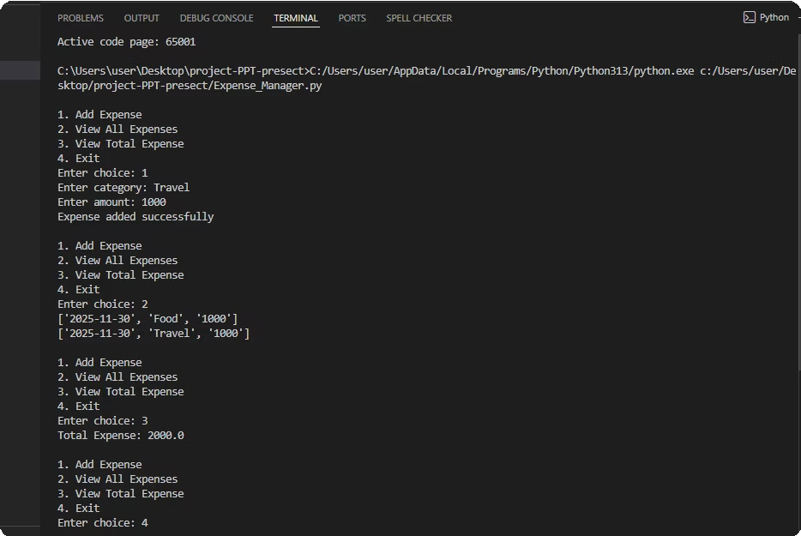
In Action: Adding an Expense
Observe the seamless process of inputting a new expense. The interface is designed for clarity, ensuring you can quickly and accurately log your spending.

Slide 18
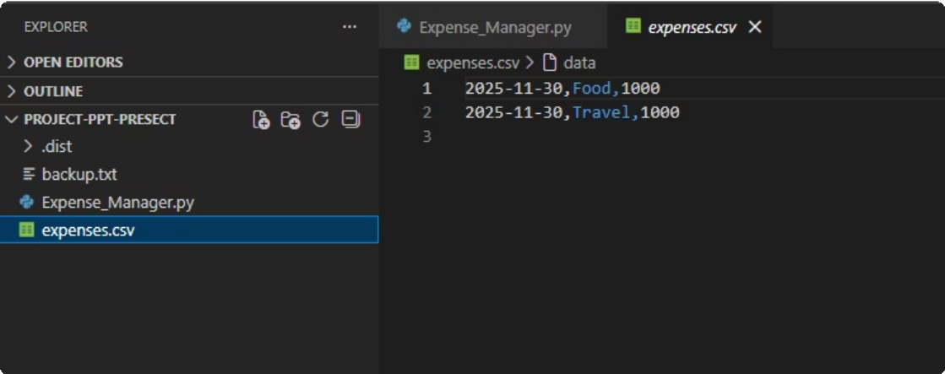
Your Spending at a Glance: Viewing Expenses
Easily review a comprehensive list of all your recorded expenses. This feature provides a clear overview, allowing you to track your financial activity effortlessly.

Slide 19
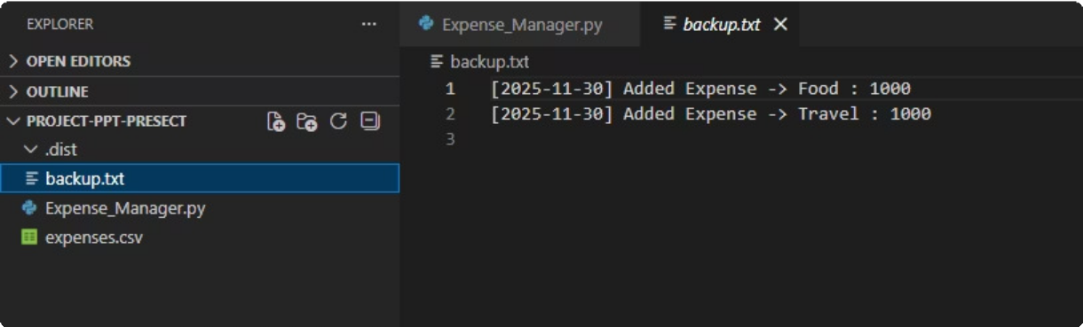
Total Clarity: Expense Calculation
The tool automatically calculates your total expenses, providing an immediate summary of your financial outflows. This feature is vital for understanding your overall spending habits.
GITHUB URL: https://github.com/giridharan637/Monay-Manger.git

Slide 20

Conclusion:
The Expense Manager System provides a simple, efficient, and reliable solution for managing personal finances. By allowing users to record income, categorize expenses, and analyze monthly spending patterns, the system helps individuals develop better financial discipline. Its user-friendly interface, modular architecture, and secure file-based storage make it accessible for beginners while still being powerful enough for practical use.

Slide 21

Thank You!

